Slide 1
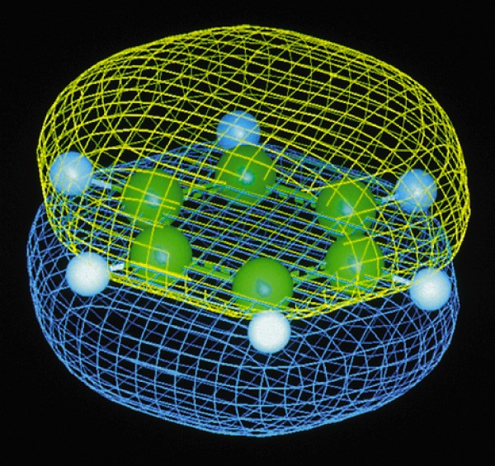
Chapter 12: Chemical Bonding II:
Additional Aspects
General Chemistry
Principles and Modern Applications
Petrucci • Harwood • Herring
8th Edition
Philip Dutton
University of Windsor, Canada
N9B 3P4
Prentice-Hall © 2002
Notes:
Thermochemistry branch of chemistry concerned with heat effects accompanying chemical reactions.
Direct and indirect measurement of heat.
Answer practical questions: why is natural gas a better fuel than coal, and why do fats have higher energy value than carbohydrates and protiens.

Slide 2
Contents
12-1 What a Bonding Theory Should Do
12-2 Introduction to the Valence-Bond Method
12-3 Hybridization of Atomic Orbitals
12-4 Multiple Covalent Bonds
12-5 Molecular Orbital Theory
12-6 Delocalized Electrons: Bonding in the Benzene Molecule
12-7 Bonding in Metals
Focus on Photoelectron Spectroscopy
Notes:
Lewis theory has shortcomings. It does not explain conduction or semiconductors. More sophisticated approaches are required.
Hybridization. Molecular orbitals from atomic orbitals.

Slide 3
12-1 What a Bonding Theory Should Do
Bring atoms together from a distance.
  e⁻ are attracted to both nuclei.
  e⁻ are repelled by each other.
  Nuclei are repelled by each other.
Plot the total potential energy verses distance.
  -ve energies correspond to net attractive forces.
  +ve energies correspond to net repulsive forces.

Slide 4
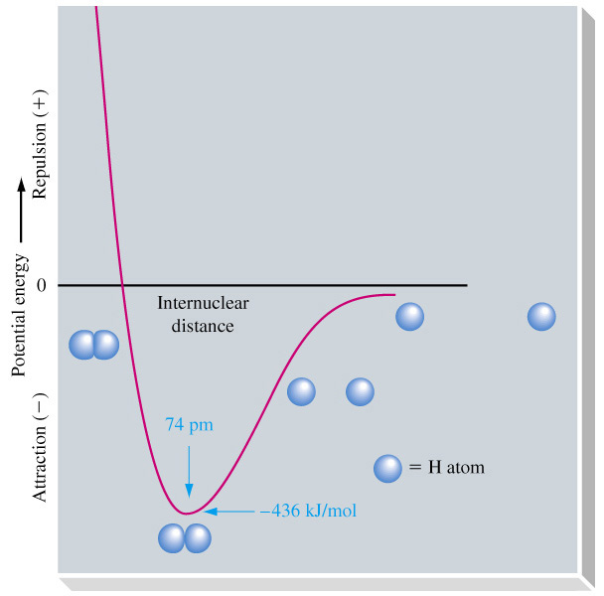
Potential Energy Diagram

Slide 5
12-2 Introduction to the Valence-Bond Method
Atomic orbital overlap describes covalent bonding.
Area of overlap of orbitals is in phase.
A localized model of bonding.

Slide 6
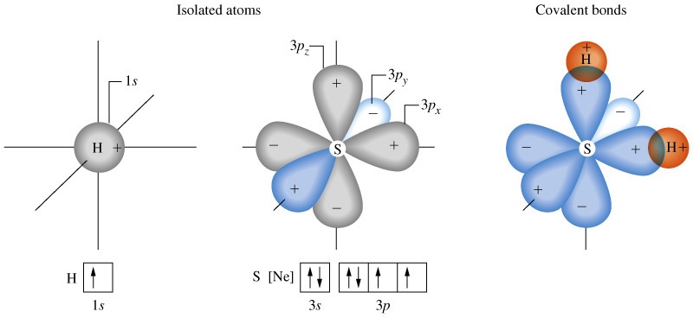
Bonding in H₂S
Notes:
Bonding atomic orbitals are shown in grey.

Slide 7
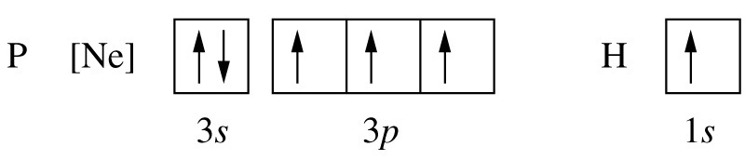
Example 12-1
Using the Valence-Bond Method to Describe a Molecular Structure.
Describe the phosphine molecule, PH₃, by the valence-bond method..
Identify valence electrons:

Slide 8
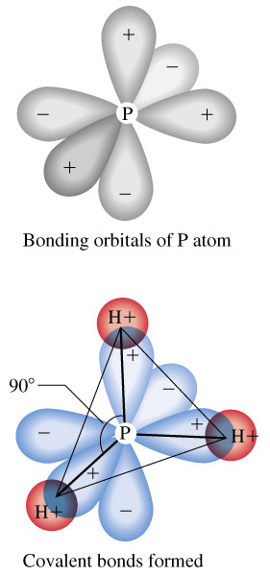
Example 12-1
Sketch the orbitals:
Overlap the orbitals:
Describe the shape: Trigonal pyramidal
Notes:
Observed bond angles are 92-94°.

Slide 9
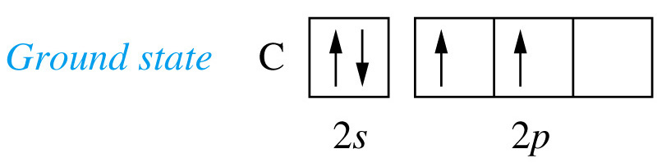
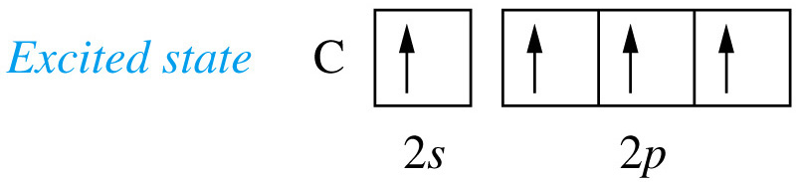
12-3 Hybridization of Atomic Orbitals

Slide 10
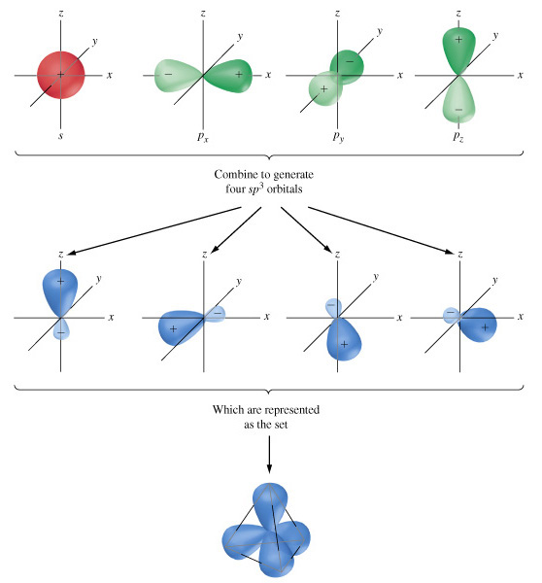
sp³ Hybridization

Slide 11
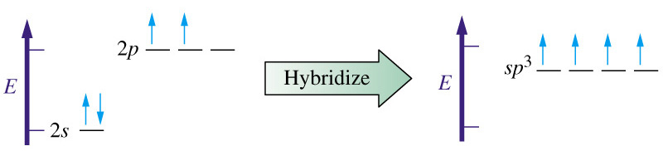
sp³ Hybridization

Slide 12
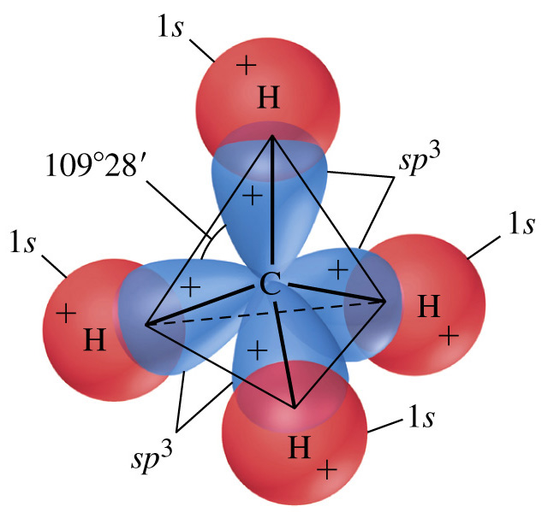
Bonding in Methane

Slide 13
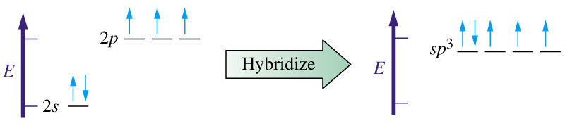
sp³ Hybridization in Nitrogen

Slide 14
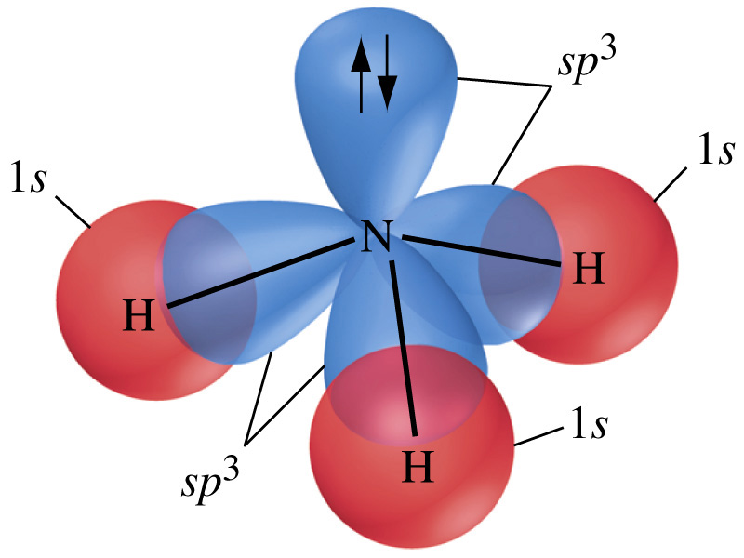
Bonding in Nitrogen

Slide 15
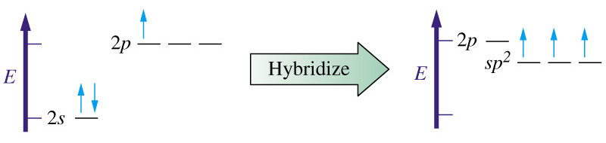
sp² Hybridization

Slide 16
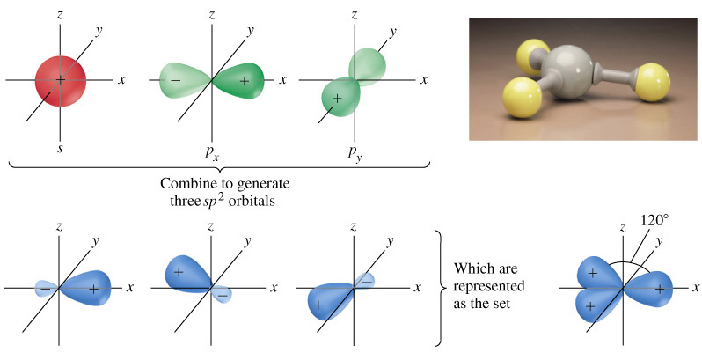
Orbitals in Boron

Slide 17
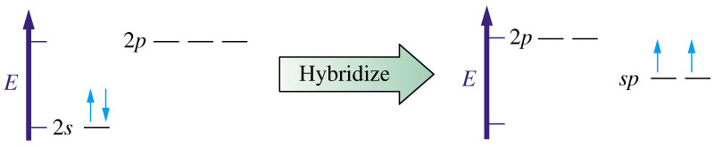
sp Hybridization

Slide 18
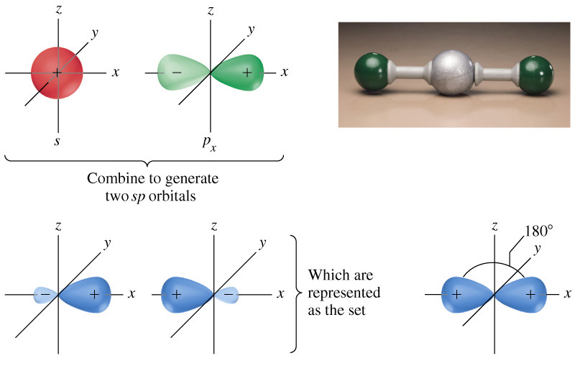
Orbitals in Beryllium

Slide 19
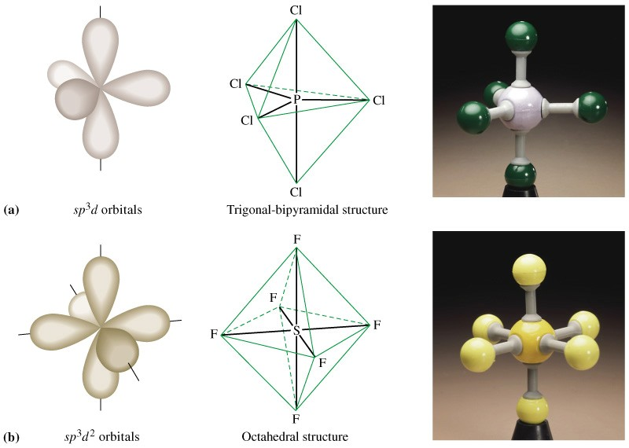
sp³d and sp³d² Hybridization

Slide 20
Hybrid Orbitals and VSEPR
Write a plausible Lewis structure.
Use VSEPR to predict electron geometry.
Select the appropriate hybridization.

Slide 21
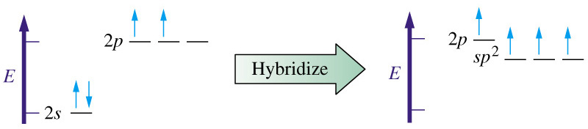
12-4 Multiple Covalent Bonds
Ethylene has a double bond in its Lewis structure.
VSEPR says trigonal planar at carbon.

Slide 22
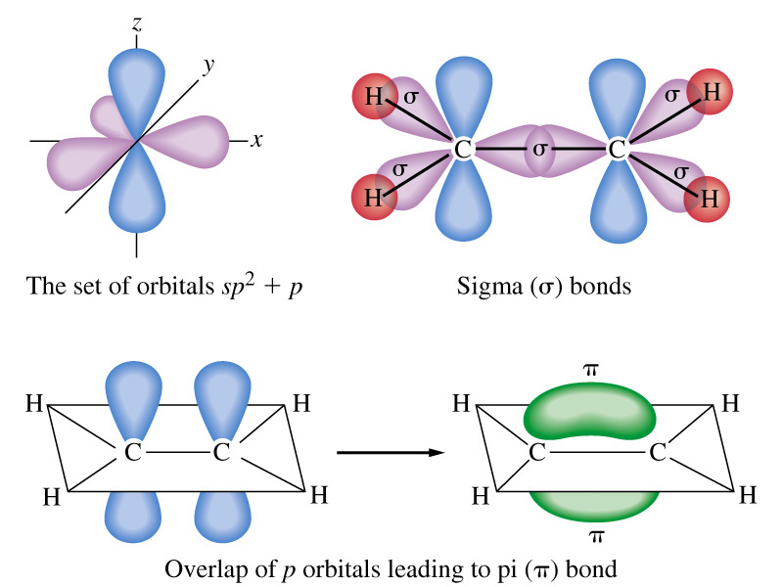
Ethylene

Slide 23
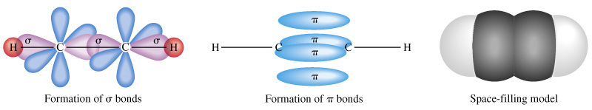
Acetylene
Acetylene, C₂H₂, has a triple bond.
VSEPR says linear at carbon.

Slide 24
12-5 Molecular Orbital Theory
Atomic orbitals are isolated on atoms.
Molecular orbitals span two or more atoms.
LCAO
  Linear combination of atomic orbitals.
Ψ₁ = φ₁ + φ₂ Ψ₂ = φ₁ - φ₂

Slide 25
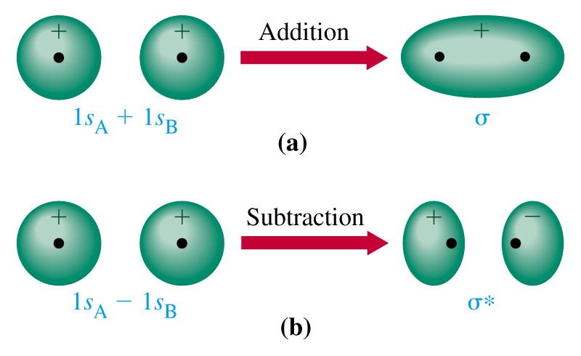
Combining Atomic Orbitals
Notes:
Bonding and antibonding molecular orbitals.

Slide 26
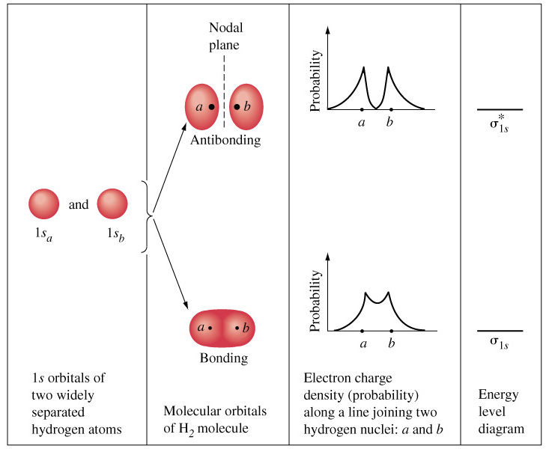
Molecular Orbitals of Hydrogen

Slide 27
Basic Ideas Concerning MOs
Number of MOs = Number of AOs.
Bonding and antibonding MOs formed from AOs.
e⁻ fill the lowest energy MO first.
Pauli exclusion principle is followed.
Hund’s rule is followed
Notes:
Pauli – maximum number of e- in an MO is two
Degenerate orbitals are filled singly before e- pair up.

Slide 28
Bond Order
Stable species have more electrons in bonding orbitals than antibonding.
No. e⁻ in bonding MOs - No. e- in antibonding MOs
Bond Order =
2

Slide 29
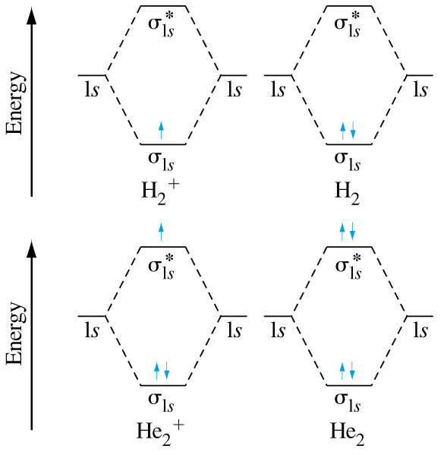
Diatomic Molecules of the First-Period
BO = (e⁻_{bond} - e⁻_{antibond} )/2
BO = (1-0)/2 = ½
H₂⁺
BO = (2-0)/2 = 1
H₂⁺
BO = (2-1)/2 = ½
He₂⁺
BO = (2-2)/2 = 0
He₂⁺

Slide 30
Molecular Orbitals of the Second Period
First period use only 1s orbitals.
Second period have 2s and 2p orbitals available.
p orbital overlap:
  End-on overlap is best – sigma bond (σ).
  Side-on overlap is good – pi bond (π).

Slide 31
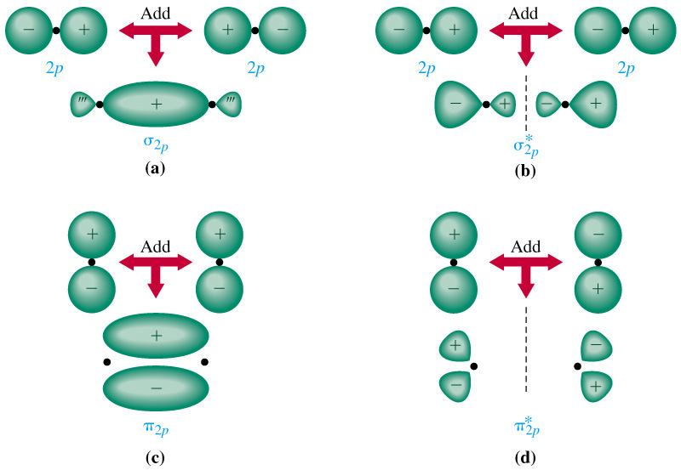
Molecular Orbitals of the Second Period

Slide 32
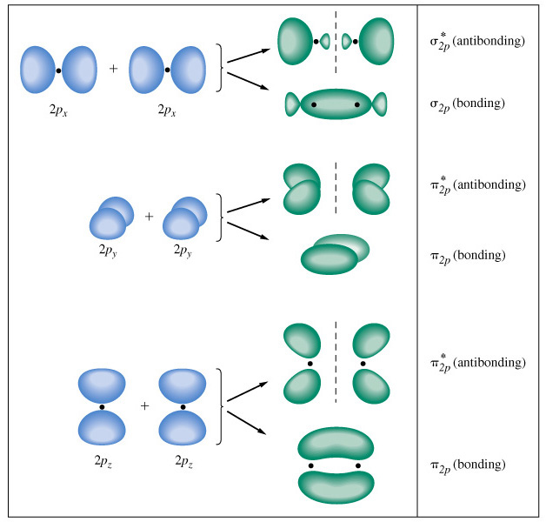
Combining p orbitals

Slide 33
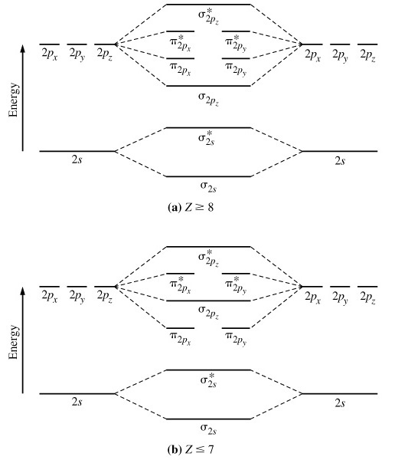
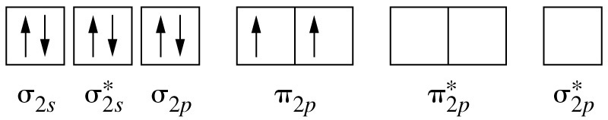
Expected MO Diagram of C₂
Prentice-Hall © 2002 General Chemistry: Chapter 12 Slide

Slide 34
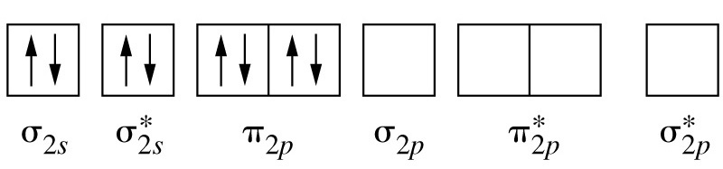
Modified MO Diagram of C₂

Slide 35
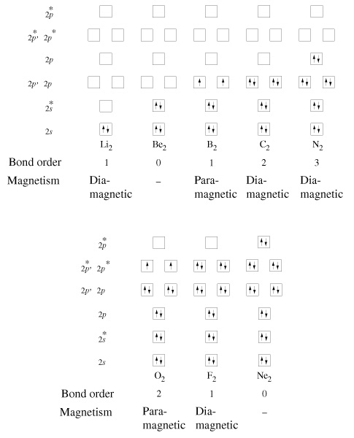
MO Diagrams of 2nd Period Diatomics
Prentice-Hall © 2002 General Chemistry: Chapter 12

Slide 36
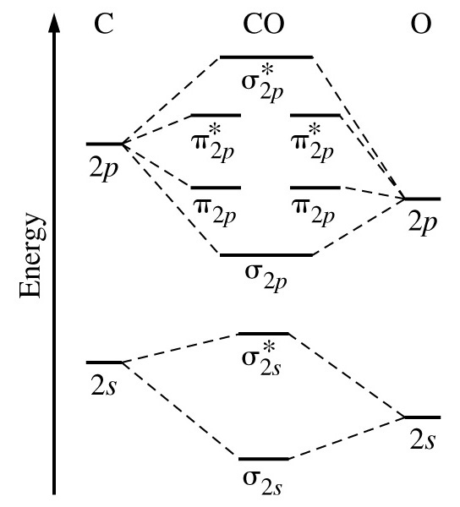
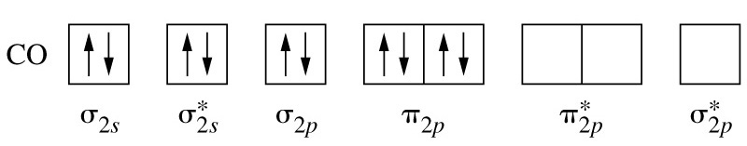
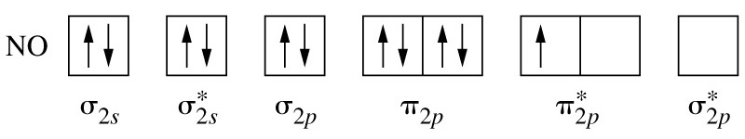
MO Diagrams of Heteronuclear Diatomics

Slide 37
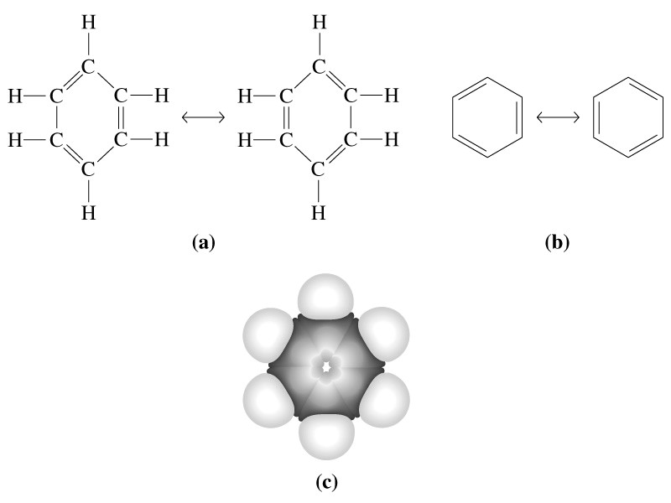
12-6 Delocalized Electrons

Slide 38
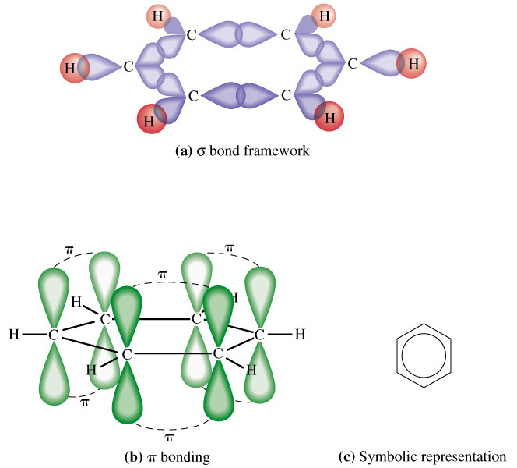
Benzene

Slide 39
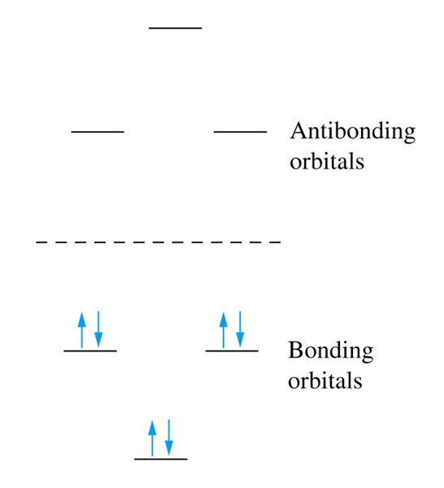
Benzene

Slide 40
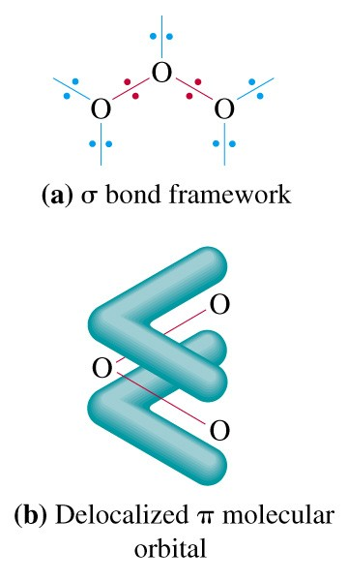
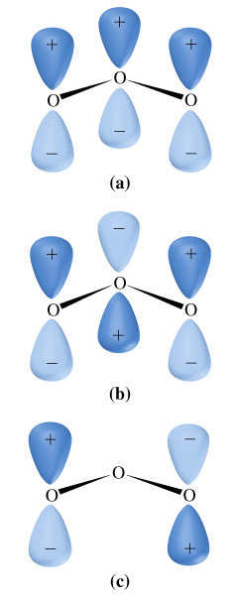
Ozone

Slide 41
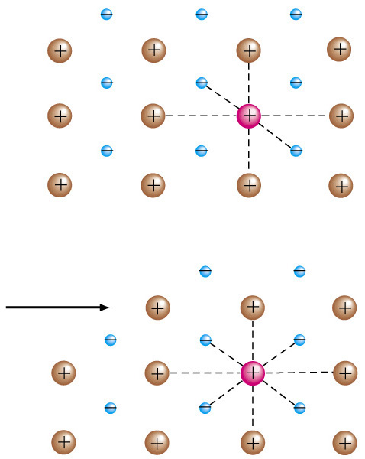
12-7 Bonding in Metals
Electron sea model
  Nuclei in a sea of e⁻.
  Metallic lustre.
  Malleability.
  Force applied

Slide 42
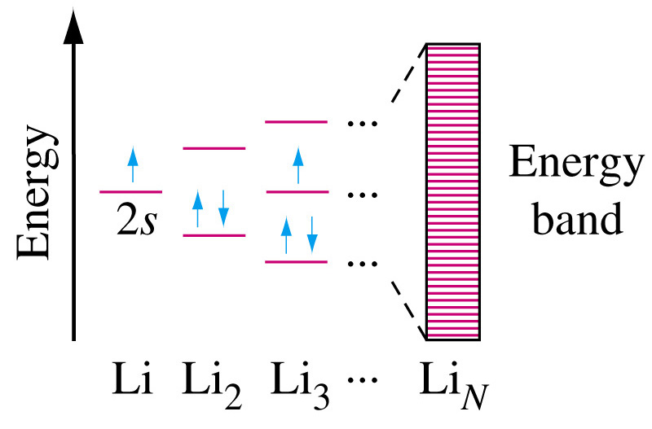
Bonding in Metals
Band theory.
Extension of MO theory.
  N atoms give N orbitals that
  are closely spaced in energy.
    N/2 are filled.
      The valence band.
    N/2 are empty.
      The conduction band.

Slide 43
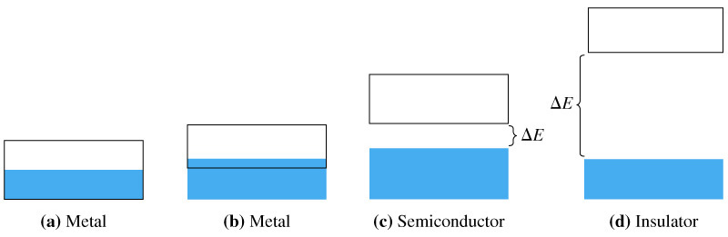
Band Theory

Slide 44
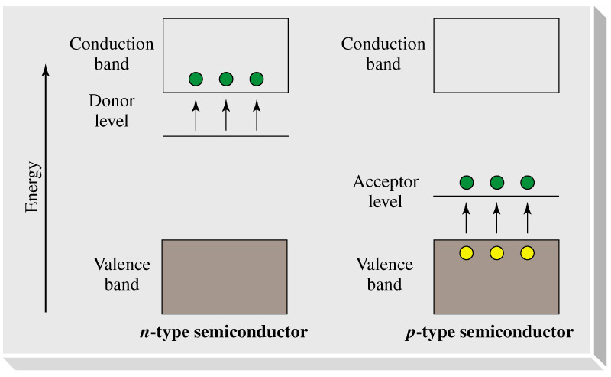
Semiconductors
Notes:
Intrinsic semiconductors: fixed band gap.
Ex. CdS, absorbs violet light and some blue, reflects less energetic light. Thus looks bright yellow.
GaAs, small band gap, all visible light is absorbed, looks black.
Extrinsic semiconductors: band gap is controlled by addition of impurities – doping.
Energy level of P is just below the conduction band of Si. P uses four of five electrons to bond to Si, one left over can be donated.
n-type semiconductor – n refers to negative, the type of charge that is MOBILE.
Energy level of Al is just above the valence band. Electrons can move into the Al orbital and leave a HOLE in the valence band. Positive charge can move around thus this is a p-type semiconductor.

Slide 45
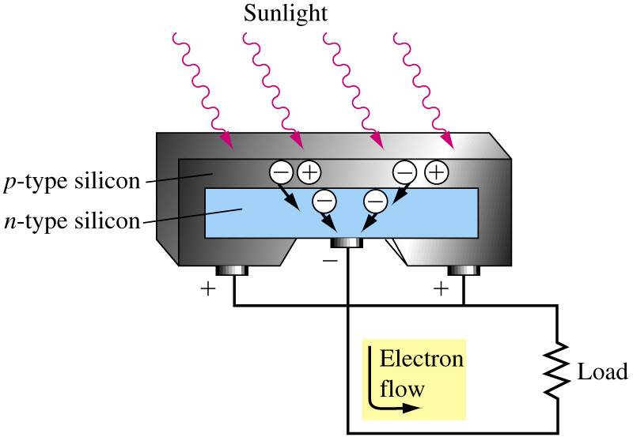
Photovoltaic Cells

Slide 46
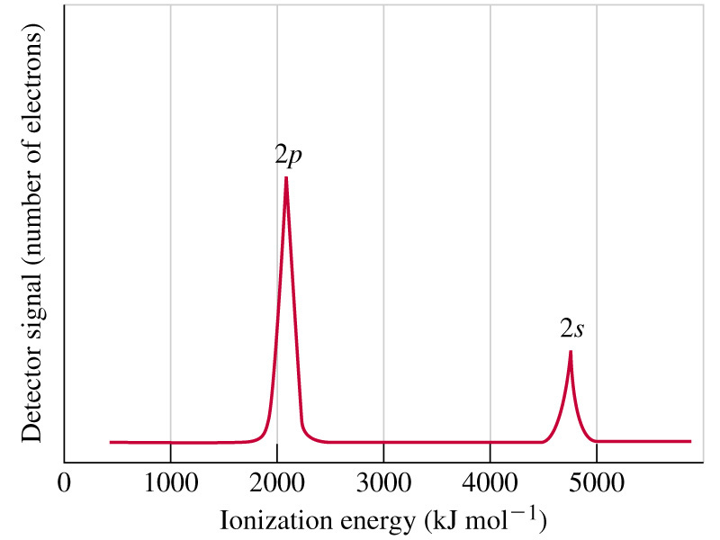
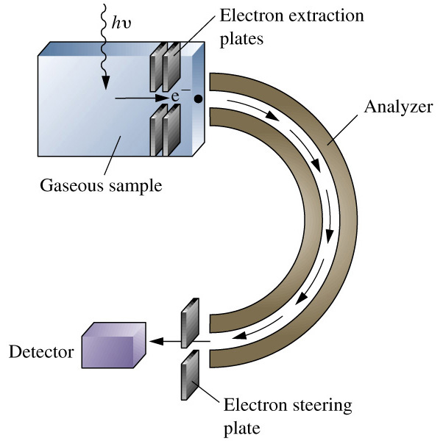
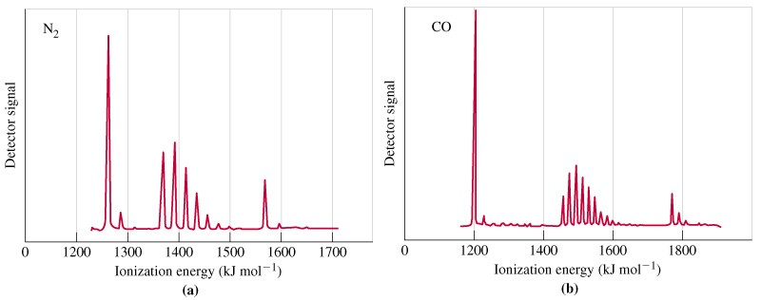
Focus on Photoelectron Spectroscopy

Slide 47
Chapter 12 Questions
1, 3, 8, 10, 16, 29, 33, 39, 45, 59, 68, 72, 76

